Slide 1
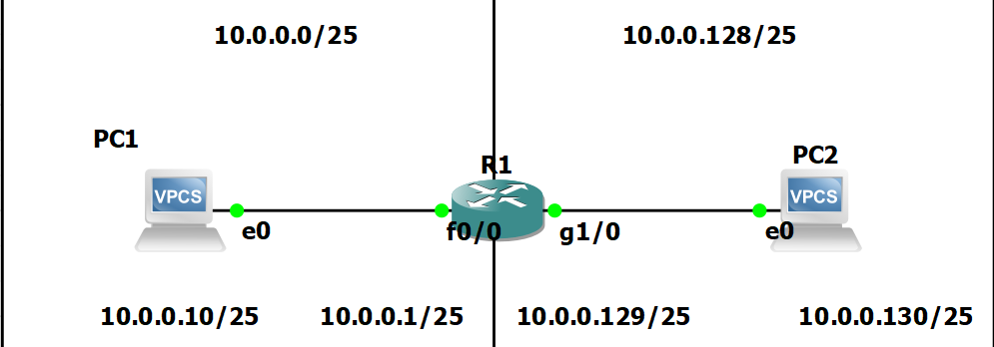
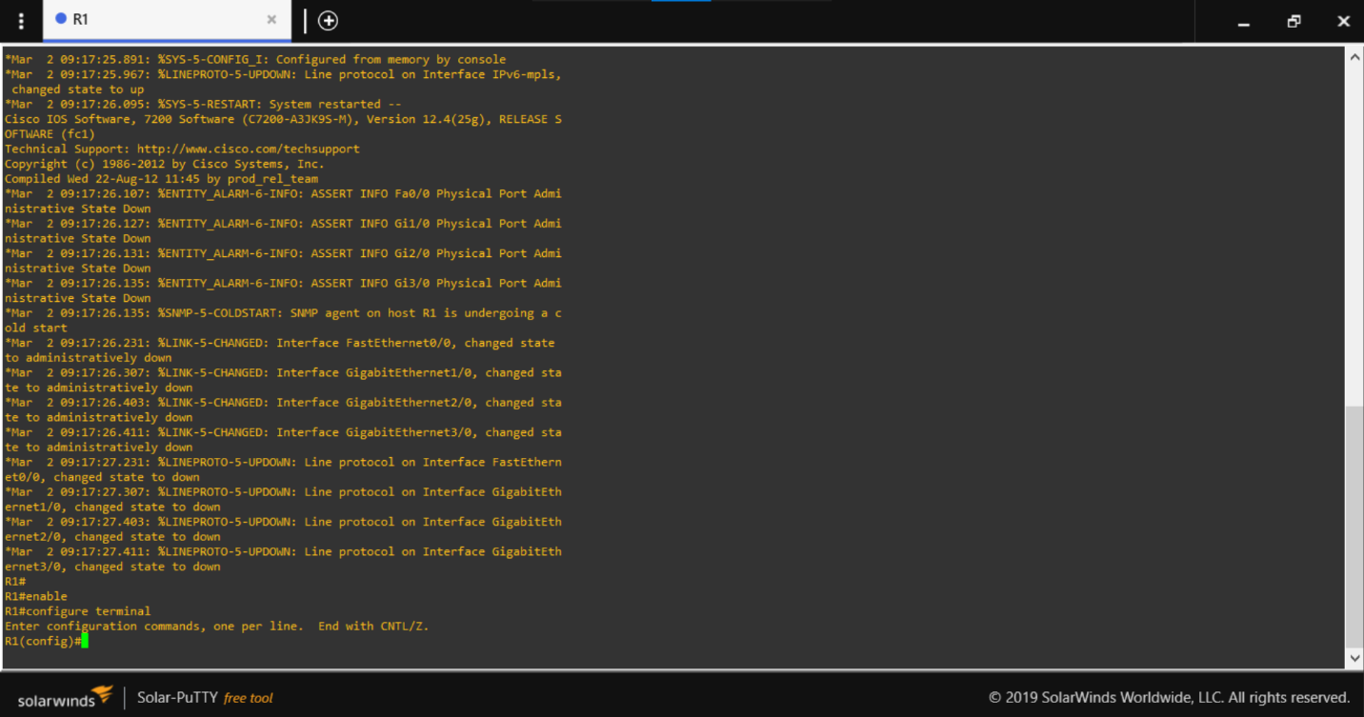
Initial Set Up To begin the project, will start with a simple diagram displaying the networks and devices on the network to reduce any further confusion. Especially to help when returning to a project or trouble shooting. Mistyping an address will cause trouble, so will keep it simple with diagrams in GNS3.
Will begin the setup with pressing the green triangle to start all instances on the screen, then double click on the router in the middle to initiate a terminal window. Will be using SolarWinds as it is included with the GNS3 install.
Boot router and start console
Enable admin mode by typing “enable” – a hashtag will appear in front of the router name instead of “>” symbol.
Move into Configuration Terminal via ‘configuration terminal’ command.

Slide 2
Initialization of Routers
Will name and apply basic configurations to the router from the configuration terminal. Each instance of #anything# will be replaced by a customized identification of your choosing.
Set hostname – hostname #name#
Ip domain name - ip domain-name #name.local# (This will allow us to create SSH keys)
Message of the day – banner motd # This router has been setup #
Establish password for console and SSH
line console 0 (setting up console password)
password #password# - IE ‘cisco’ to ensure we do not forget the password
login (forcing Login password)
logging sync
line aux 0 (setting aux line)
password #password#
login
logging sync
Great we configured User access passwords
Now to enable a password for Privileged mode!
In the configuration terminal type – enable secret #password#
In the configuration terminal type – service password-encryption ( to encrypt plain text passwords)
Great! Privileged mode is secure.

Slide 3
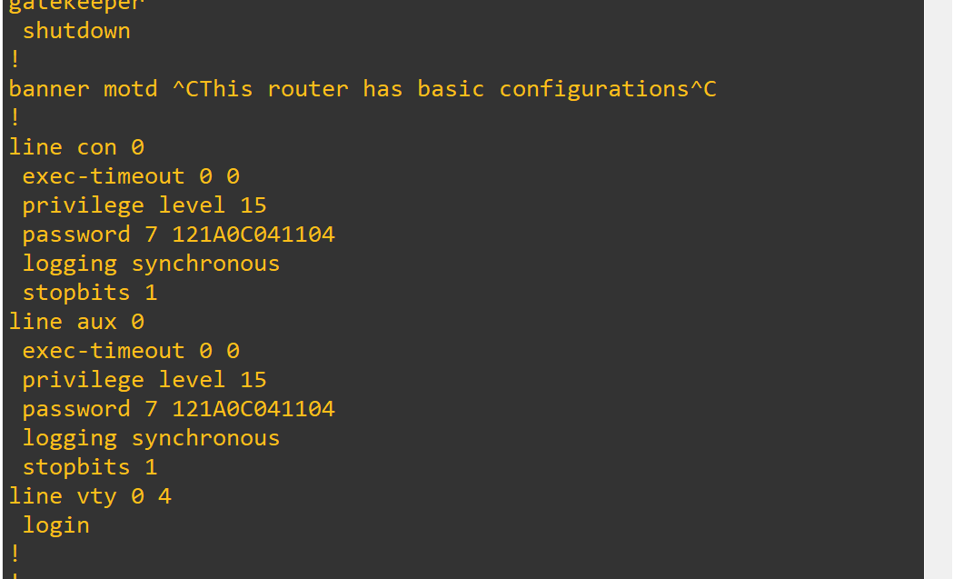

Slide 4
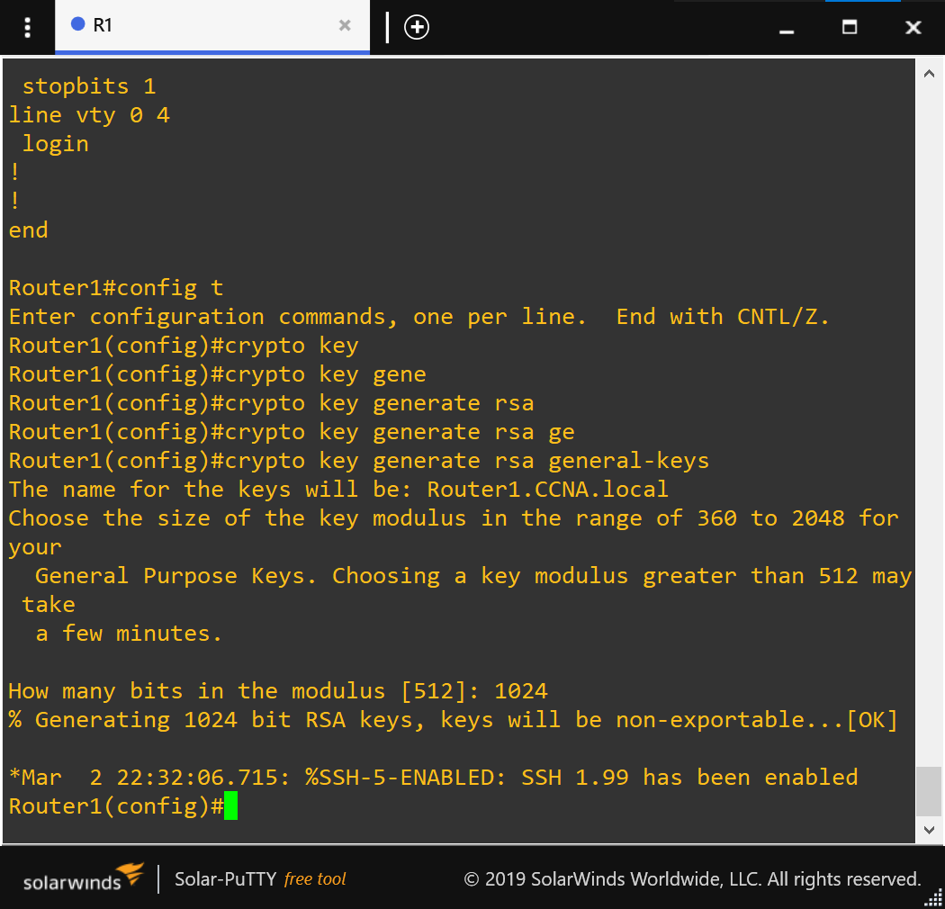
Now we will enable SSH to have the option of remotely accessing the router.
In the config terminal: crypto key generate rsa general-keys
Choose the key size – 1024 or 2048
Ip ssh version 2 (to enable SSH login)
username #name# secret #secret# (creating a username and password for SSH login)
line vty 0 4 (to configure virtual lines 0-4 at the same time)
transport input ssh (only allow SSH connections via those lines)
login local (tells the router to verify username and password against internal database.
Logging sync

Slide 5
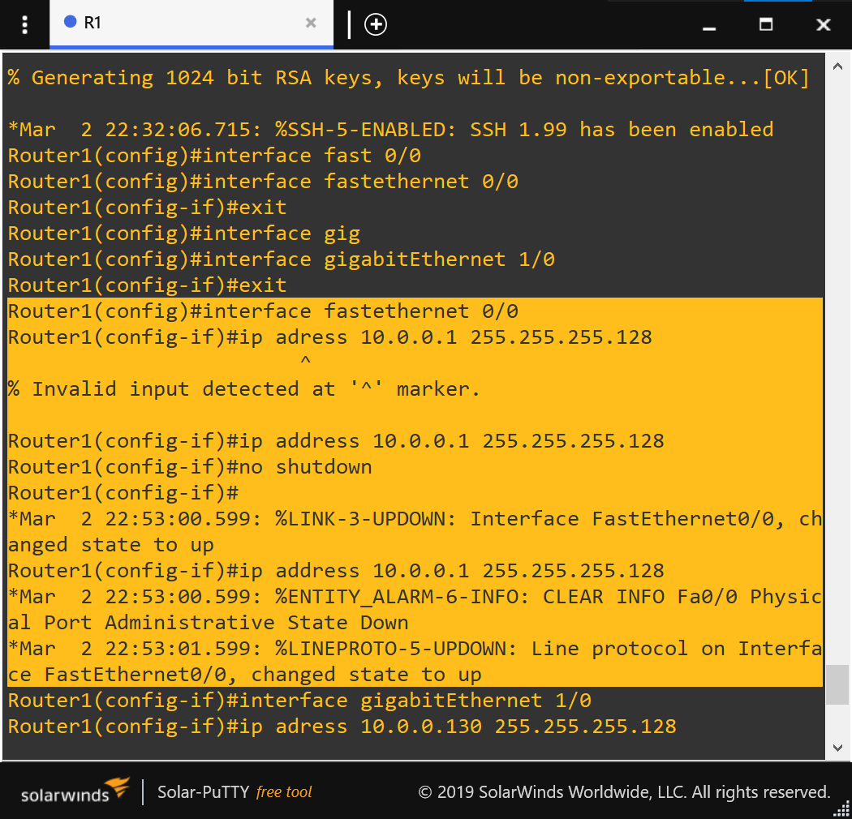
Now let’s configure the connections to the router. According to our diagram, fast Ethernet port 0/0 and gigabit port 1/0 need to be configured.
Interface fastethernet 0/0
Ip address 10.0.0.1 255.255.255.128
No shutdown ( enables the port to power on)
Interface gigabitenthernet 1/0
Ip address 10.0.0.129 255.255.255.128
No shutdown

Slide 6
SUMMARY OF ROUTER CONFIGURATION
At any point enter “?” to show all available prompts at the current location.
Config t
Hostname #name#
Banner motd # something #
Line con 0
Login
Password #anything#
Logging sync
Line aux 0
Login
Password #anything#
Logging sync
Exit
Enable secret #anything#
Service password-encryption
Ip domain-name #anything#
Username #name# secret #password#
Crypto key generate rsa general keys (crypto key generate rsa ?)
1024
Ip ssh version 2
Line vty 0 4
Login local transport input ssh
Exit
Interface f0/0
Ip address 10.0.0.1 255.255.255.128
No shut
Interface g0/0
Ip address 10.0.0.129 255.255.255.128
No shut
Exit
Copy run start

Slide 7
PC CONFIGURATION
To configure the PCs on the network, will make sure the node is started and access it via putty. In the terminal issue the following commands to set IP to the corresponding IP on the diagram.
Ip #ip address# #subnetmask# #default gateway#
Show ip (will display the current ip set to the node)
Make sure to save the configuration with “save #name of file#”

Slide 8
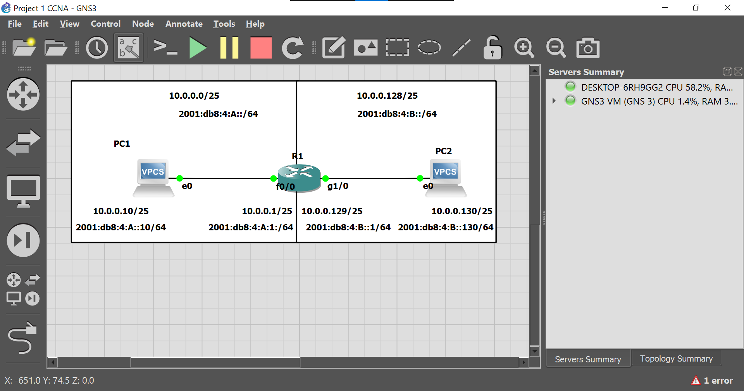
IPV6 Setup
Will now enable ipv6 addresses on the interfaces and will assign each interface with an address according to the diagram
Config terminal
Ipv6 unicast-routing
Int f0/0
Ipv6 address 2001:db8:4:A::/64
Int g0/1
Ipv6 address 2001:db8:4:B::/64
Exit
Copy run start
Configuration Complete

